Slide 1
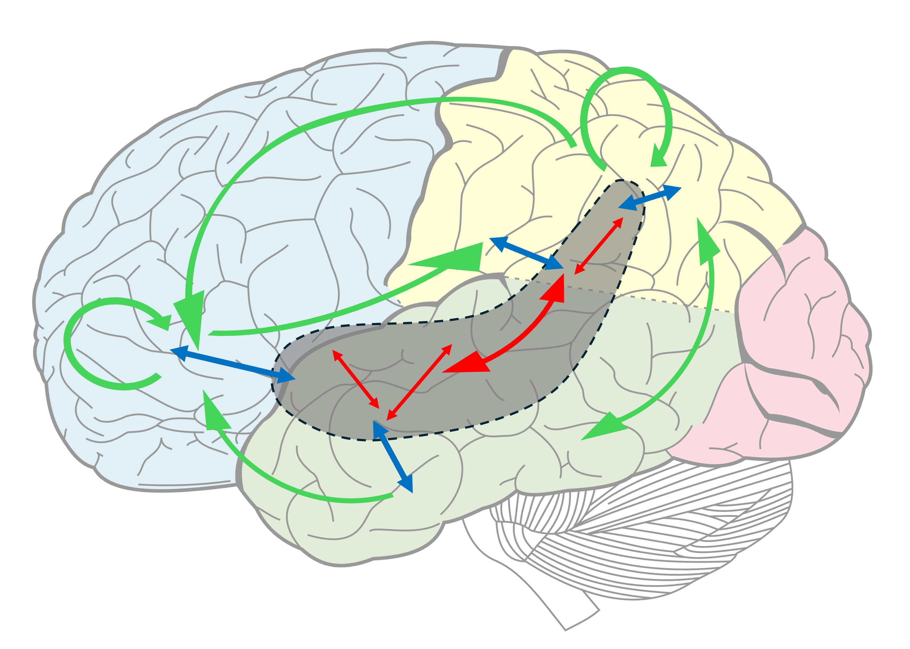
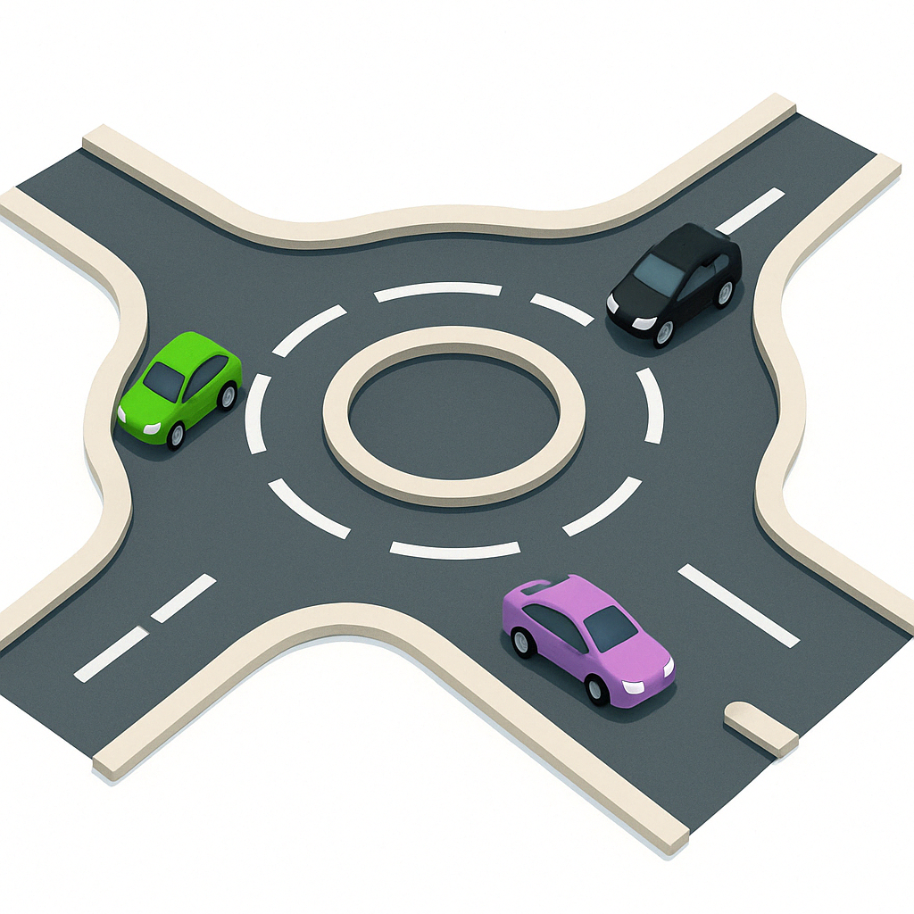
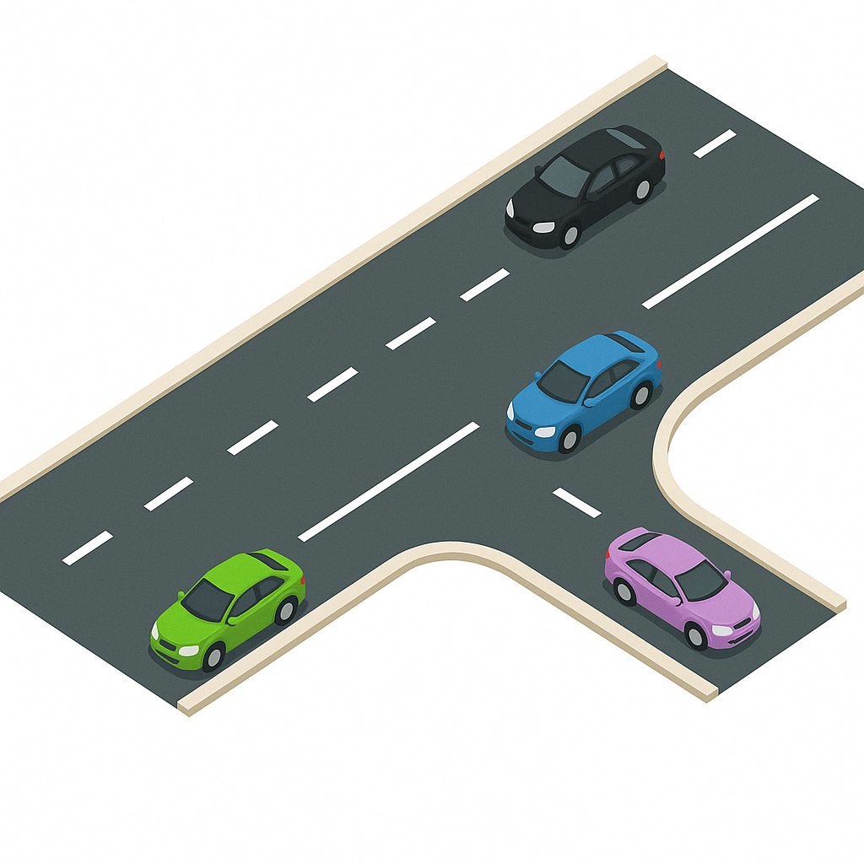
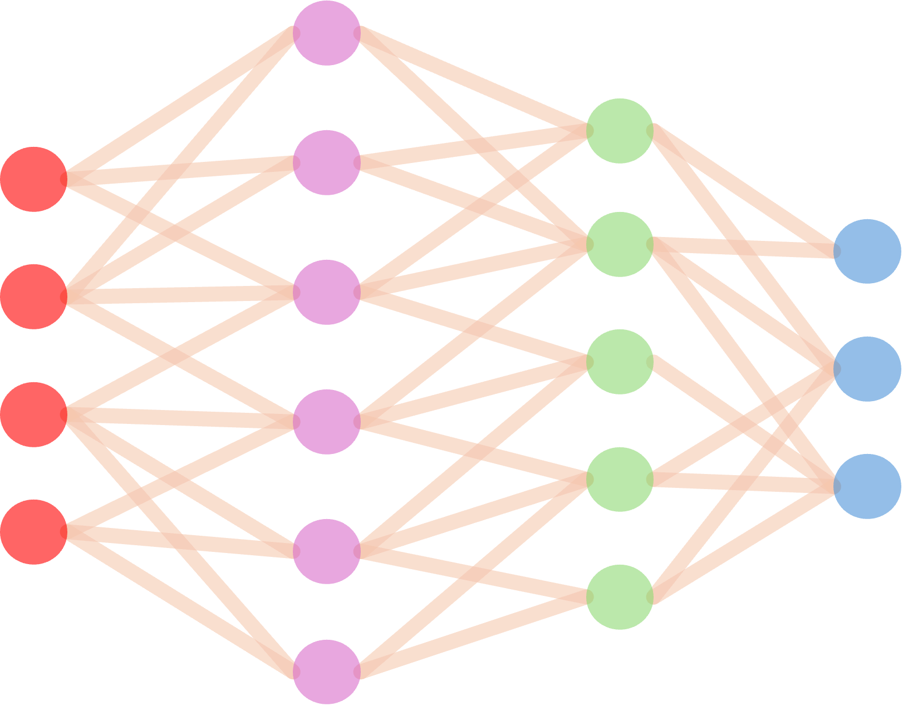

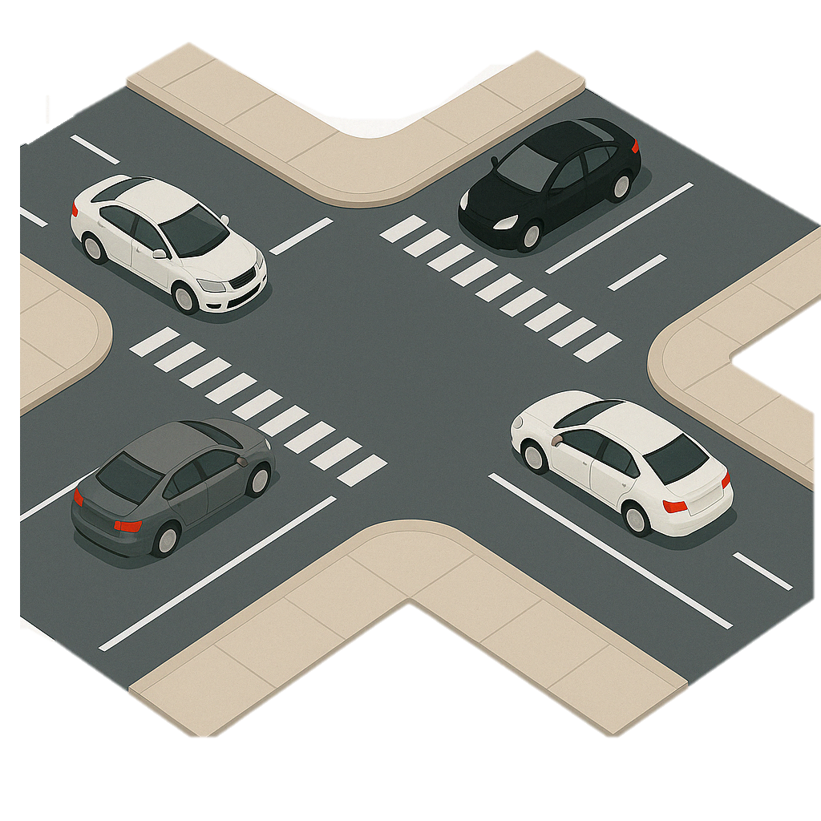

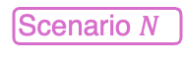
a
Continual Training & Adaptation
b
Scenario 2
Scenario $N$
Time
Scenario 1
Scenario 3
forgetting?
neocortex memory
Continual Training & Adaptation
hippocampus memory
diversity
equal probability
interplay
CLS in brain
CLS in memory
c
Past scenario 1
Past scenario 2
Current scenario
Past scenario 1
CLS empowers DNN
Long-term
Short-term
CLS in learning strategy
Notes:
主图汇总 20250419

Slide 2
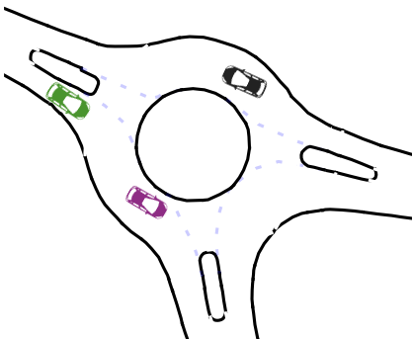
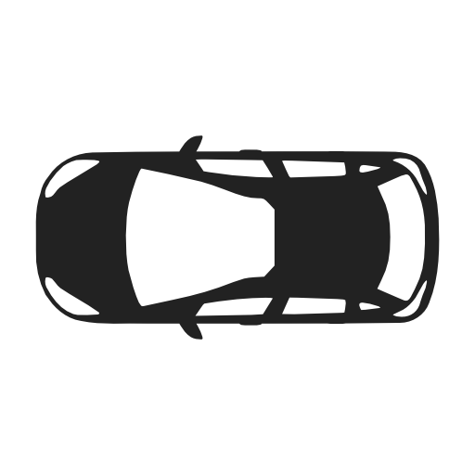
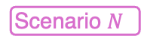
a
Continual Training & Adaptation
b
Scenario 2
Scenario $N$
Time
Scenario 1
Scenario 3
forgetting?
neocortex memory
Continual Training & Adaptation
hippocampus memory
diversity
equal probability
interplay
CLS in brain
CLS in memory
c
Past scenario 1
Past scenario 2
Current scenario
Past scenario 1
CLS emerging in DNN
CLS in
learning strategy
Long-term
Memory slow model
Short-term
Memory fast model
Notes:
主图汇总

Slide 3
Continual Training & Adaptation
forgetting?
Continual Training & Adaptation
a. AV continually passes diverse scenarios

Slide 4
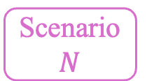
Scenario
2
Scenario
$$N$$
Time
Scenario
1
Scenario
3
neocortex memory
diversity
hippocampus memory
the interplay between neocortex and hippocampus
Replay Memory Buffer Selection
b. Complementary learning system

Slide 5

Past scenario 1
Past scenario 2
Complementary Learning System
Long-term
Memory
Short-term
Memory
Knowledge Consolidation
Memory Replay
c. Mitigate the forgetting by memory replay

Slide 6
Notes:
CL场景1

Slide 7
Notes:
CL场景2

Slide 8
Notes:
CL场景3

Slide 9
Notes:
CL场景3

Slide 12
